Slide 1

IBM Data Science

Slide 2
1. What is Data Science ?
2. Open Source tools for Data Science
3. Data Science Methodology
4. Python for Data Science and AI
5. Databases and SQL for Data Science
6. Project
7. Data Analysis with Python
8. Data visualization with Python
9. Machine Learning with Python
10. Applied Data Science Capstone
There are 10 courses in this certification

Slide 3
Data science is the art of uncovering the insights and trends that are hiding behind data. It's when you translate data into a story. So use storytelling to generate insight. And with these insights, you can make strategic choices for a company or an institution.
1. What is Data Science?

Slide 4
In this course, I have learned about various open source tools for Data Science.
Skill Network Labs
Jupyter Notebooks
Apache Zeppelin Notebooks
Rstudio IDE
IBM Watson studio
2. Open Source tools for Data Science

Slide 5
In this course I have learned about the major steps involved in tackling a data science problem. - The major steps involved in practicing data science, from forming a concrete business or research problem, to collecting and analyzing data, to building a model, and understanding the feedback after model deployment. - How data scientists think!.
3. Data Science Methodology

Slide 6
In this course I have learned about Python Basics like types, expressions, variables, string operations, lists, tuples, sets, dictionaries, Loops, objects and classes, file handling, pandas and numpy.
4. Python for Data Science and AI

Slide 7
In this course, I have learned about relational database concepts that helps to apply foundational knowledge of the SQL language, performing SQL access in a data science environment. The emphasis in this course is on hands-on and practical learning. I have also created some database instances in the cloud. I have done series of hands-on labs, practice building and running SQL queries in this lab. I have also learned how we can access databases from Jupyter notebooks using SQL and Python.
5. Databases and SQL for Data Science

Slide 8
In this course I have learned about Importing Datasets, Cleaning the Data , Data frame manipulation, Summarizing the Data. It includes following parts: Data Analysis libraries, use of Pandas, Numpy and Scipy libraries to work with a sample dataset. I have used this library to load, manipulate, analyze, and visualize cool datasets.
6. Data Analysis with Python

Slide 9
This course was all about several data visualization libraries in Python like Matplotlib, Seaborn, and Folium and how we can tell a compelling story by visualizing the data and findings from the data
7. Data visualization with Python

Slide 10
In this course I have learned about some of machine learning topics like supervised and unsupervised learning, classification, clustering and some Python libraries like Sci-kit learn and Scipy.
8. Machine Learning with Python

Slide 11
In this course I have learned about FourSquare API ( It is a restful API to retrieve the data about venues in different neighborhoods around the world and I have applied this learnings to complete my Capstone Project
9. Applied Data Science Capstone

Slide 12
Capstone Project

Slide 13
Toronto encompasses a geographical area formerly administered by many separate municipalities. These municipalities have each developed a distinct history and identity over the years, and their names remain in common use among Torontonians. Former municipalities include East York, Etobicoke, Forest Hill, Mimico, North York, Parkdale, Scarborough, Swansea, Weston and York. Throughout the city there exist hundreds of small neighbourhoods and some larger neighbourhoods covering a few square kilometres.
Background
Toronto is the provincial capital of Ontario and the most populous city in Canada, with a population of 2,731,571 in 2016. Current to 2016, the Toronto census metropolitan area (CMA), of which the majority is within the Greater Toronto Area (GTA), held a population of 5,928,040, making it Canada's most populous CMA. Toronto is the fastest growing city in North America. and is the anchor of an urban agglomeration, known as the Golden Horseshoe in Southern Ontario, located on the northwestern shore of Lake Ontario.

Slide 14
Introduction
Having such vast population and big geographical area, there also exists big competition between businesses. Therefore it became very challenging for stake holder or new business to decide which area they should start their business to get higher revenue with lowest possible competition.
Main objective of this project
This project try to solve the problem by suggesting the Target Audience which are the best locality to open new restaurants and gaining maximum profits in Toronto.

Slide 15
Data to be used
1. Data source : « https://en.wikipedia.org/wiki/List_of_areas_of_London »
Description - City of London Neighborhood Profiles use this Census data to provide a portrait of the demographic, social and economic characteristics of the people and households in each City of Toronto neighborhood
2. Data source : Foursquare API
Description : By using this API we will get all the venues in each neighborhood. We can filter these venues to get the Restaurants.

Slide 16
Approach
Collect the City of London data from data source
Using FourSquare API we will find all venues for each neighborhood.
Cluster the neighborhood based on the venues
Find the best location to start a restaurant after further analyzing the cluster results

Slide 17
Libraries to be used
pandas and numpy for handling data.
request module for using FourSquare API.
geopy to get co-ordinates of City of Toronto.

Slide 18
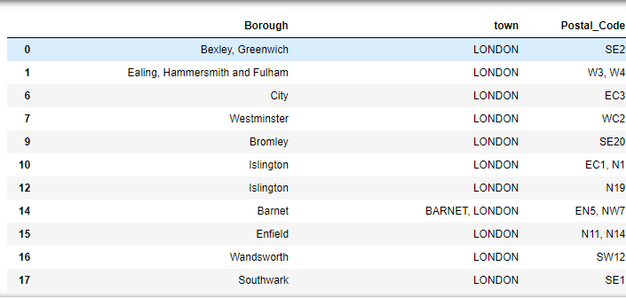
Step 1
Load data from dataset
in pandas Dataframe.
Getting Latitude and Longitude for each address geopy library.

Slide 19
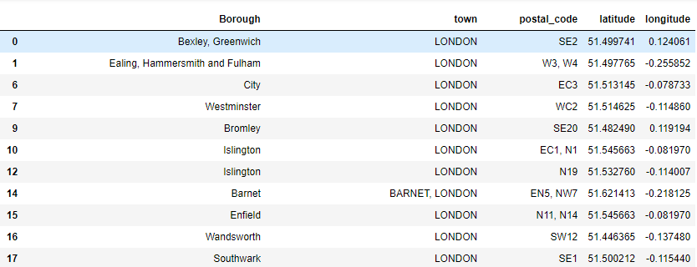
Step 2
Get the most popular venue for each Borough and Neighborhood.

Slide 20
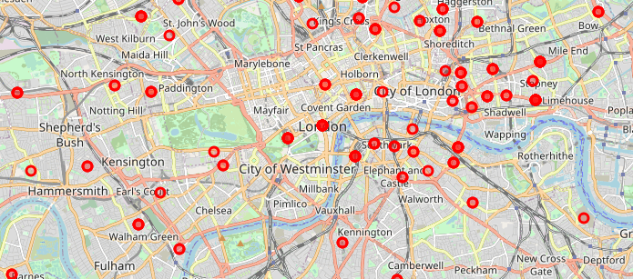
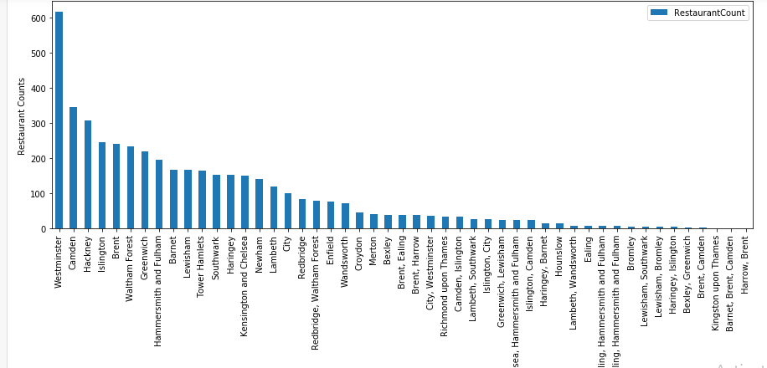
Step 3
Get the Borough and Neighborhood using FourSquare API and desplay the initial cluster.

Slide 21
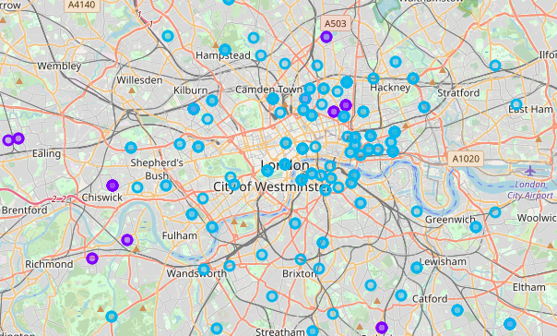
Step 4
Cluster Borough and Neighborhood using
K-mean

Slide 22
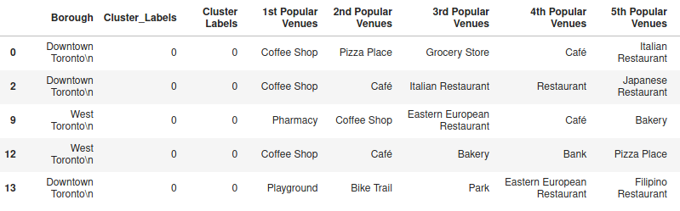
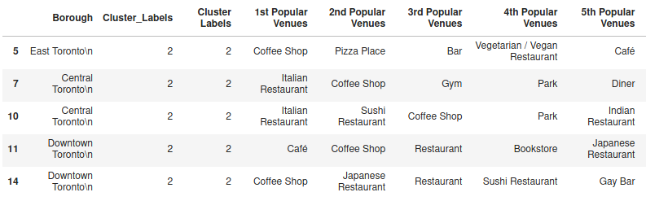
List of Clusters with high density restaurants
Result
Cluster 1
Cluster 3

Slide 23
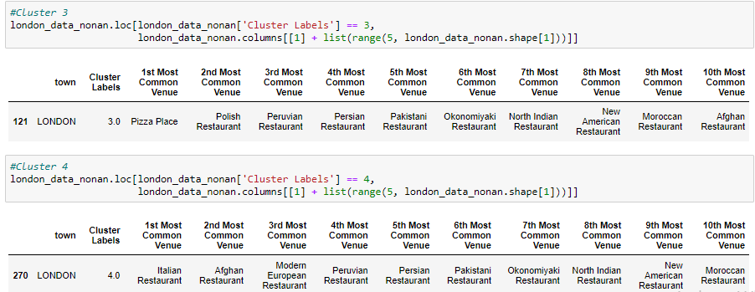
Result
Most promising places

Slide 24
Conclusion
Cluster 1,2 and five already have a large number of open restaurants
Cluster 3 and 4 have least number of restaurants
Therefore we can consider Central and east London a good location to start a new restaurant business
Final decision on optimal restaurant location will be made by stakeholders

Slide 25
The accuracy of data depends purely depends on the data provided by FourSquare
Limitation

Slide 26

Thank you

